Slide 1
Data
Data is the raw form of information, a collection of facts, figures, symbols or observations that represent details about events, objects or phenomena.
By itself, data may appear meaningless, but when organized, processed and interpreted, it transforms into valuable insights that support decision-making, problem-solving and innovation.
  We use data to find patterns, make predictions, and support decisions.

Slide 2
Importance Data
Decision-making and insights: Organizations use data to make better decisions. Raw data becomes useful when transformed into insights with the help of analytics.
AI/ML and Innovation: Data is the fuel for artificial intelligence and machine learning. More and higher-quality data means better training, more accurate predictions.
Digital transformation: The rise of Big Data has enabled new capabilities i.e. from real-time analytics to personalized services.

Slide 3
Type of Data based on source or scope
Population Data
Sample Data

Slide 4
Population Data
A population refers to the entire set of individuals, objects, or data points that you want to study. It can be large or small depending on the scope of your research.
  For example, all students in a school or all people in a country.
  It provides a complete picture and is usually denoted by N.
Population Characteristics are mean(), Standard deviation(), Proportion(P), Median, Percentiles and so on.
Notes:
When to use a Population:
Populations are used when your research question requires it, or when you have access to data from every member of the population. Usually, it is only straightforward to collect data from a whole population when it is small, accessible, and cooperative.
Example:
A marketing manager at a small local bakery wants to understand customer preferences.
They collect data on every customer’s bread purchase over a month.
Since the customer base is limited and accessible, they analyze the entire population to identify trends.

Slide 5
Sample Data
A sample is a subset of the population that is selected for analysis. It's used when studying the entire population is impractical or impossible. Sampling allows for inferences about the population using statistical techniques.
  For example, if the population is all students in a school, a sample could be 50 students randomly chosen from different classes to participate in a survey.
  It offers an estimate and is denoted by n.
Parameters (like population mean) describe the population, while statistics (like sample mean) describe the sample. Sampling enables us to make inferences about the population using statistical techniques.
Notes:
When to use a Sample:
When your population is large in size, geographically dispersed, or difficult to contact, it’s necessary to use a sample. With statistical analysis, you can use sample data to make estimates or test hypotheses about population data.
Example:
You're researching smartphone usage among teenagers in a city.
The population includes all teenagers aged 13–18, which could be tens of thousands.
You select a random sample of 500 teens from different schools.
This sample participates in surveys to provide insights into broader usage patterns.
Data samples can be collected either randomly or sequentially, depending on the experimental design.

Slide 6
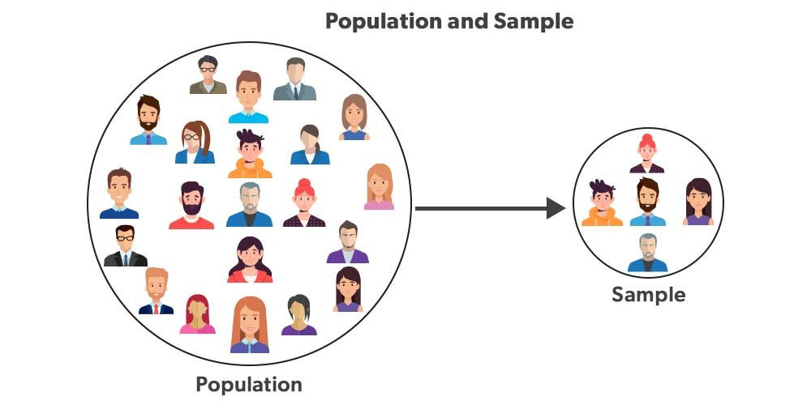
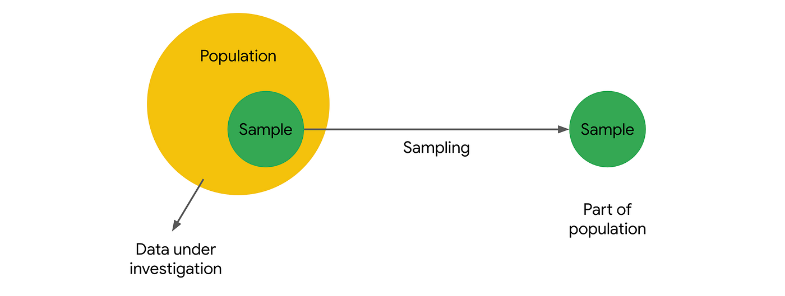
Population vS Sample
Notes:
Population
The population includes all members of a specified group.
Collecting data from an entire population can be time-consuming, expensive, and sometimes impractical or impossible.
Includes all residents in the city.
Sample
A sample is a subset of the population.
Samples offer a more feasible approach to studying populations, allowing researchers to draw conclusions based on smaller, manageable datasets
Consists of 1000 households, a subset of the entire population.

Slide 7
Types of Data Based on Nature or Type of Values
Data can be categorized in different ways depending on how it is collected, stored and represented. Broadly, it falls into the following types:
Quantitative Data
Qualitative Date
Structured Data
Unstructured Data
Semi-Structured Data
Big Data

Slide 8
Quantitative (Numerical) data
Quantitative data is information that can be measured, counted and expressed in numerical form. It provides objective values that can be analyzed statistically to identify patterns, trends and relationships.
  Represents numbers and measurable values.
  Can be divided into: Discrete data (Whole numbers) and Continuous data (Values on a scale).
  Widely used in research, finance, engineering and business analytic
Example: Age of people = 25, number of customers visiting a store = 100, temperature readings = 32.5°C,
sales revenue = 5000 TK

Slide 9
subtype of Quantitative data
Subtype | Meaning | Example
Discrete Data | Whole numbers; countable values. | Number of students = 50, Goals scored = 3
Continuous Data | Can take any value within a range (measured). | Height = 172.5 cm, Temperature = 36.7°C

Slide 10
Qualitative (categorical) Data
Qualitative data is descriptive, non-numeric information that explains qualities, characteristics or categories rather than quantities. It helps understand opinions, experiences and meanings behind behaviors.
  Focuses on qualities, attributes and categories rather than numbers.
  Often collected through surveys, interviews or observations.
  Useful for understanding opinions, motivations and behaviors.
Example: Customer feedback (“satisfied”, “unsatisfied”), Gender (Male/Female), Color (Red, Blue, Green)

Slide 11
Subtype of Qualitative Data
Subtype | Meaning | Example
Nominal Data | Categories with no order. | Gender = Male/Female, Color = Red/Blue/Green
Ordinal Data | Categories with a natural order or ranking. | Size = Small < Medium < Large, Rating = Good < Better < Best

Slide 12
Structured data
Structured data is information organized into a predefined format (rows and columns) that makes it easily searchable and manageable by traditional databases.
  Stored in relational databases or spreadsheets.
  Easy to process with SQL and other tools.
  Best suited for tasks requiring accuracy and consistency.
Example: Bank transactions, employee records, product inventories.

Slide 13
Unstructured data
Unstructured data is raw information that does not follow a predefined structure or format making it harder to organize and analyze with conventional tools.
  Accounts for over 80% of data generated globally.
  Requires advanced tools (AI, NLP, computer vision) to extract insights.
  Common in social media, multimedia and IoT applications.
Example: Emails, images, videos, voice recordings, PDF documents.

Slide 14
Semi-structured data
Semi-structured data combines aspects of structured and unstructured data. It does not reside in traditional tables but still contains tags or markers that provide a loose structure.
  Provides a balance between flexibility and structure.
  Easier to analyze than unstructured data, but less rigid than structured data.
  Often used in web applications, IoT devices and log systems.
Example: JSON files, XML documents, NoSQL databases, sensor logs.

Slide 15
Big data
Body

Slide 16
Chart of Types of Data
Data based on source or scope
Data
D Based on Nature
or
Type of Values
Sample
Population
Quantitative
Qualitative
Structured
Unstructured
Semi-structured
Discrete
Nominal
Continuous
Ordinary

Slide 17
Statistics
Statistics is a branch of mathematics concerned with collecting, organizing, analyzing, and interpreting numerical data. It is recognized as a distinct scientific discipline due to its broad applications across numerous fields, including science, economics, healthcare, social sciences, and data science.
  Helps make sense of complex data through quantitative models.
  Plays a critical role in decision-making in fields like weather forecasting, stock market analysis, insurance, and data science.

Slide 18
Data science
Data science is the domain of study that deals with vast volumes of data using modern tools and techniques to find unseen patterns, derive meaningful information, and make business decisions.
Examples
  Weather forecasting
  Cricket batting average
  Poll results before elections

Slide 19
Type of statistics
Descriptive Statistics
Inferential Statistics

